Slide 1
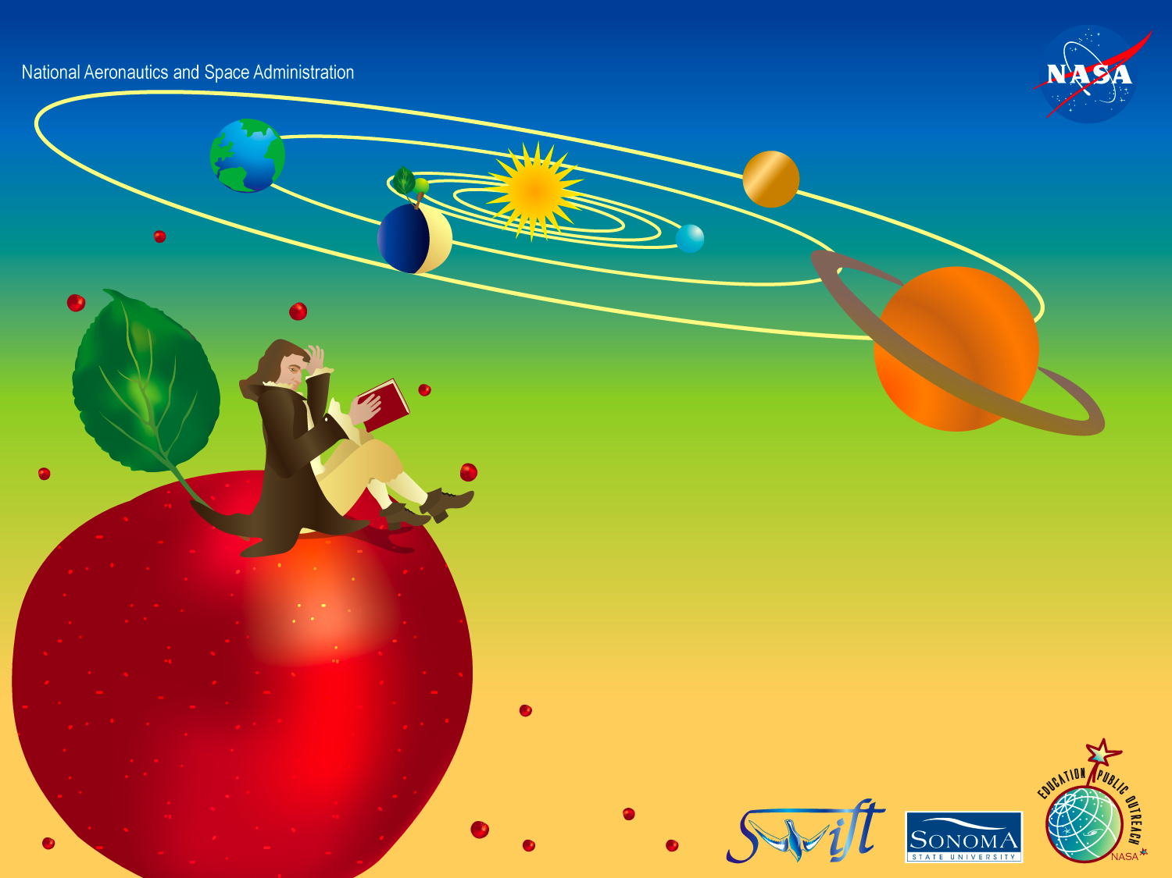
Newton’s Laws of Motion
Lynn Cominsky and Kevin McLin
NASA Education and Public Outreach
Sonoma State University

Slide 2

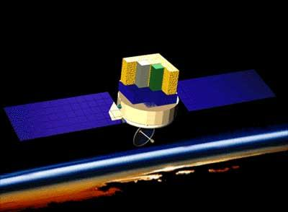
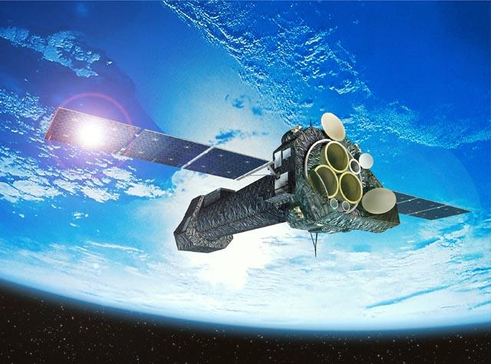
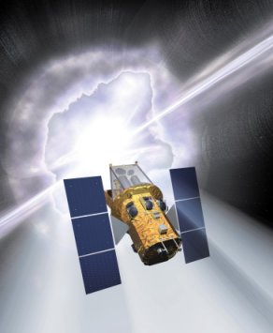
NASA at SSU
Who are we?
Education and Public Outreach at Sonoma State University in northern California
A group of students, faculty and staff working collaboratively to educate the public about current and future NASA high energy astrophysics missions.
Fermi
XMM-Newton
Swift
October 30, 08

Slide 3


Swift Explorer Mission
What is Swift?
Swift: Not an acronym!
Gamma ray burst finder
Detects GRBs in soft gamma rays
“Swiftly” turns to aim instruments
Relays position to ground for
follow-up observations
Launched November 20, 2004
October 30, 08

Slide 4
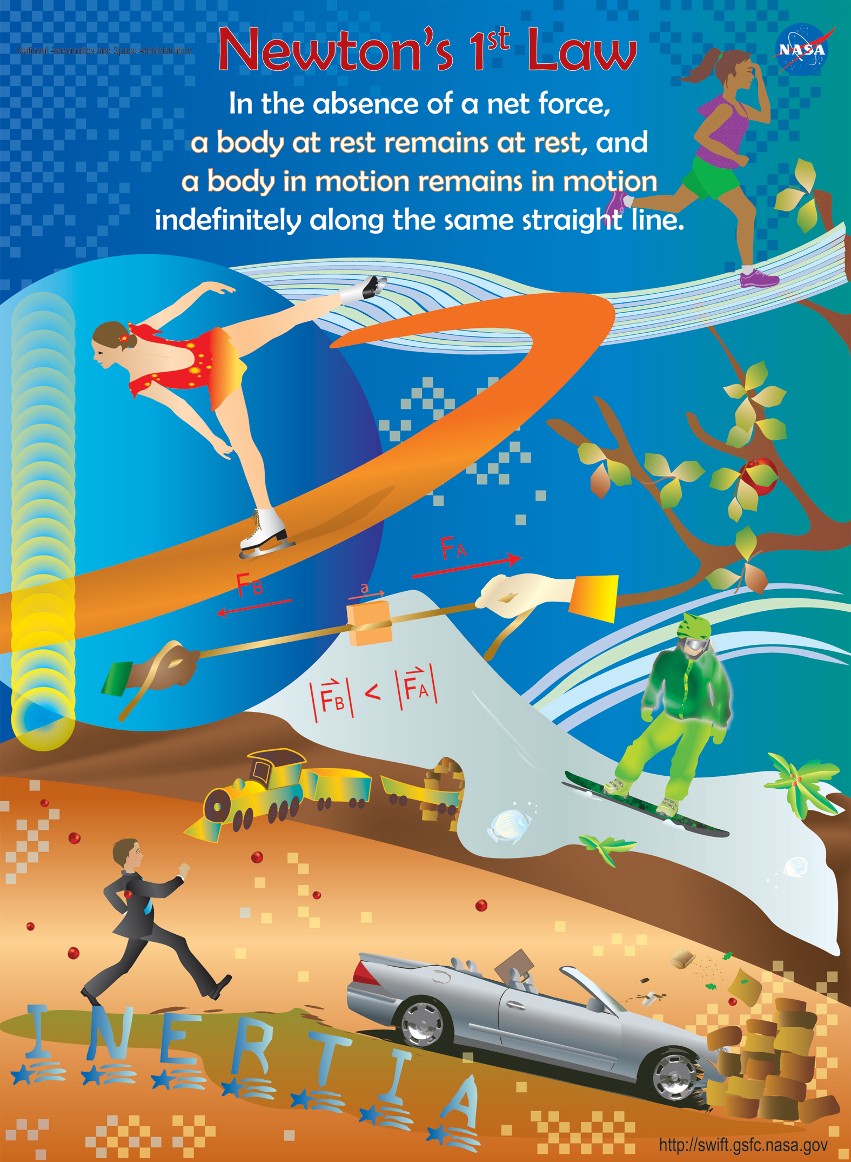
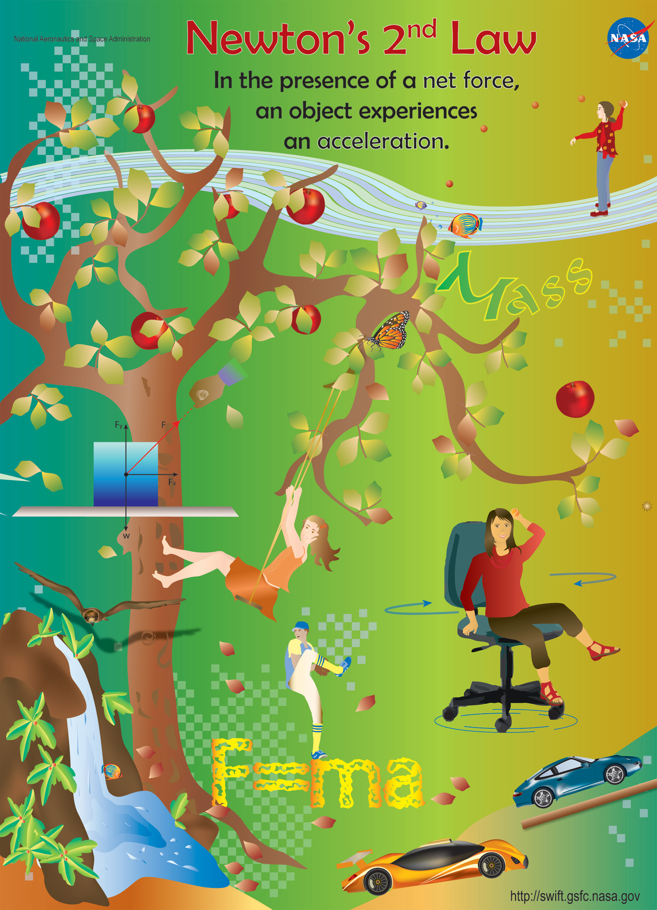
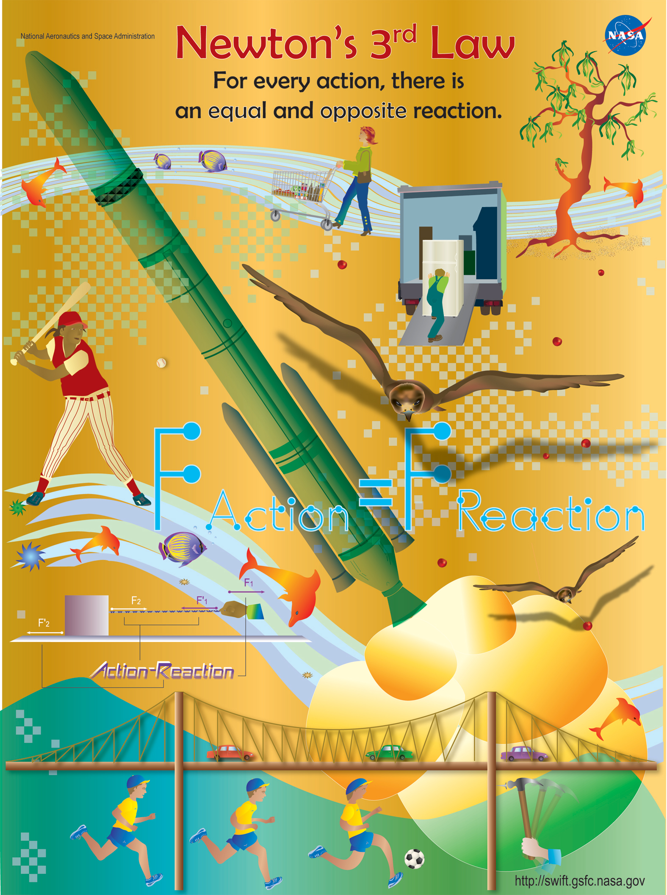
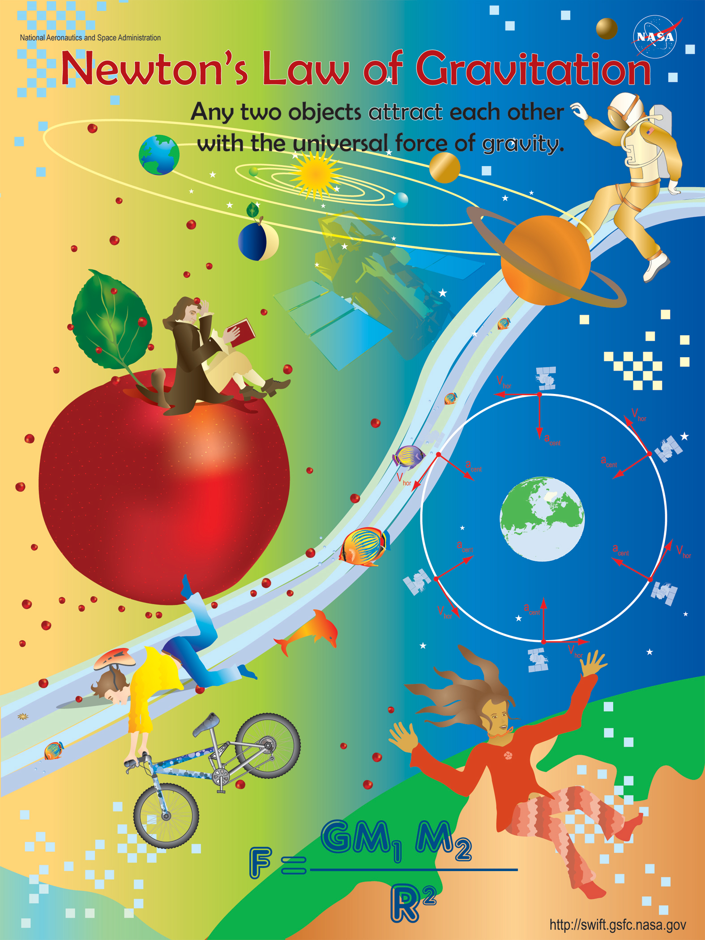
Newton’s Laws Poster Set
Newton’s Laws
Depict and explain Newton's 3 laws of motion and Law of gravitation with “Swift connections.” A set of classroom activities accompanies each poster, which were created to complement each other as an overall unit.
October 30, 08

Slide 5
Newton’s Law Poster Set
Each poster has:
Background information for the teacher
Pre-activity reading for the student
“Swift connections”
Classroom-ready activity
Assessment rubric
Extension activities that connect the classroom observations back to the Swift satellite
Additional resources
Standards alignment information
October 30, 08

Slide 6

Essential Questions
What are the properties of inertia?
How do common experiences with unbalanced forces help us to understand Newton’s First Law?
October 30, 08

Slide 7
Pre-activity Discussion
What happens when you are riding in a car with a seat belt on, and the car starts or stops suddenly?
What would happen if you were not wearing your seat belt?
What is providing the unbalanced force or the car?
Can you think of some more examples when your body is in motion and it is acted on by an unbalanced force?
October 30, 08

Slide 8
Classroom activity
Newton’s Law of Inertia
Make a little figure out of playdough
Figure out how to set up your ramp
Predict what will happen when the car rolls down the ramp - then TRY IT!
Predict what happens when it hits a heavy obstacle at the bottom – then TRY IT!
Predict what happens when it hits a light obstacle at the bottom – then TRY IT!
October 30, 08
Notes:
Born one year after Galileo’s death.
Died 1728
Alchemists believed in mysticism and thought there was a simple way to turn common metals into gold.
The other creator of calculus was Gottfried Leibniz who invented the famous integral sign.

Slide 9
Newton’s First Law of Motion
Also known as Newton’s Law of Inertia.
Newton’s First Law of motion states that a body at rest will remain at rest unless acted upon by an unbalanced force.
It also states that a body in motion will maintain that motion, in the same direction and with the same speed, unless acted upon by an unbalanced force.
October 30, 08

Slide 10
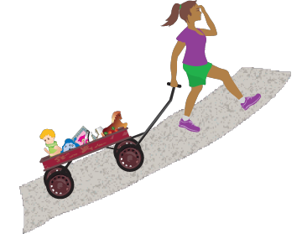
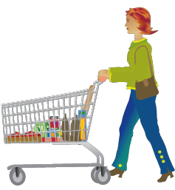
Definitions
Newton’s Law concepts
Force – a push or a pull.
Has direction and magnitude.
Can be represented by an arrow.
Mass – amount of stuff or matter there is in an object.
Weight – measure of the force acting on an object in a gravitational field.
October 30, 08
Notes:
How are mass and weight different?

Slide 11
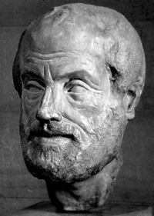
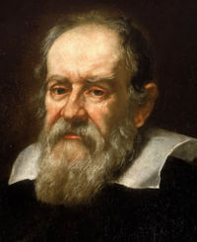
Ideas about Force
Aristotle – force required to keep objects in motion.
Galileo – no force is necessary to keep objects in motion
Newton – expanded Galileo’s ideas into 3 laws of motion and had great insights into the force of gravity (1687)‏
Around 350 BCE
Around 1600
October 30, 08
Notes:
Aristotle and his peers made assumptions based on contemplation rather than experimentation.
Galileo, known as the father of modern science, relied on experimentation to make his predictions.

Slide 12
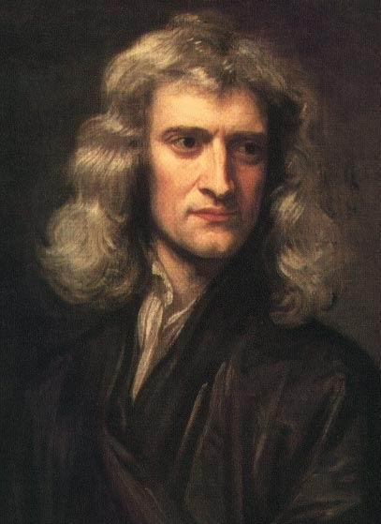
Sir Isaac Newton
Newton in History
Born January of 1643
Mathematician, Physicist, Astronomer, Alchemist
Showed that visible light is made of a spectrum
Co-creator of Calculus
Deemed “more important than Einstein”
October 30, 08
Notes:
Born one year after Galileo’s death.
Died 1728
Alchemists believed in mysticism and thought there was a simple way to turn common metals into gold.
The other creator of calculus was Gottfried Leibniz who invented the famous integral sign.

Slide 13

How does the 1st Law relate to ?
Newton’s 1st Law & Swift
November 20, 2004
To see the video of the Swift launch, visit
http://www.nasa.gov/mission_pages/swift/multimedia/
October 30, 08
Notes:
It should be noted there are external forces acting on the spacecraft due to the sun, etc. but locally there is no net force.

Slide 14
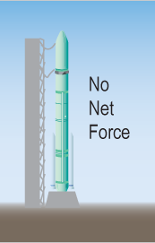
Newton’s 1st Law & Swift
Sitting on the launch pad in the nose cone of the Delta 2 rocket there was no net external force acting on the satellite.
October 30, 08
Notes:
It should be noted there are external forces acting on the spacecraft due to the sun, etc. but locally there is no net force.

Slide 15
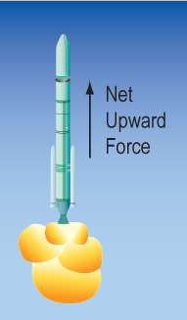
Newton’s 1st Law & Swift
When the rocket fired its boosters an unbalanced force was applied to the rocket causing the rocket and the Swift satellite to rise.
October 30, 08

Slide 16
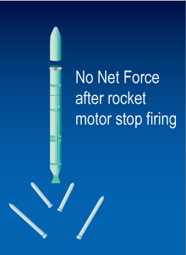
Newton’s 1st Law & Swift
When bolts holding Swift to the rocket retracted, even though there was nothing holding the satellite to the rocket, they continued to move together.
October 30, 08

Slide 17
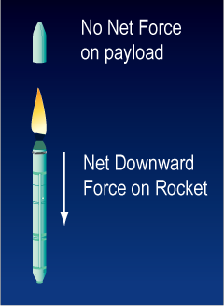
Newton’s 1st Law & Swift
The firing of the reverse thrusters on the rocket puts an unbalanced force which causes the rocket to reverse direction. Because Swift was not attached to the rocket it continued to move forward in a straight line according to Newton’s First Law.
October 30, 08

Slide 18
Newton’s 1st Law Poster
Ask your students: How do the drawings on the poster illustrate Newton’s First Law?
Jogger
Figure Skater
Hands pulling on a rope
Snowboarder
Train
Car hitting a wall
October 30, 08
Notes:
Figure skater: To begin moving, a figure skater must apply a force using her skates. Once in motion, she’ll continue to glide along the ice in a straight line for a long time unless she applies another force.
Hands pulling on rope: When each end of a rope is pulled, the rope will move in the direction of whoever is pulling harder – whoever is applying more force. In this case, the magnitude or strength of A (on the right) is greater than that of B (on the left), so the rope accelerates to the right.
Snowboarder: A snowboarder experiences a force due to gravity which pulls her down. She will move in a straight line unless she applies a force to the board, changing direction.
Train: A train is a very massive object, and therefore has a lot of inertia. Once in motion, it is very difficult to stop, requiring a very large force to slow it.
Jogger: A jogger experiences many forces while running: gravity, the push of her feet, the friction of her shoes on the ground, and air resistance. Her legs, together with the friction of her shoes, overcomes her inertia to propel her forward.
Car hitting the wall: A car rolling down a hill is being moved by the force of gravity. When the car hits the wall, the greater inertia of the wall stops it. But anything not attached to the car will still move forward, so the man running after the car will lose his coffee, his lunch, and his briefcase.

Slide 19
Standards Alignment
Physical Science (Grades 5-8, 9-12)
Motions and Forces - Unifying Science Concepts and Processes; Systems, order, organization; Evidence, models, and explanation; Change, constancy, and measurements
Science As Inquiry - Understanding scientific concepts; Understanding of the nature of science; Skills necessary to become independent inquirers about the natural world
Algebra (Grades 6-12) - Understanding patterns, relations, and functions; Represent and analyze mathematical situations
Measurement (Grades 6-12) - Understand and use measurable attributes of objects; Apply appropriate techniques, tools, and formulas
Data Analysis - Select, create, and use appropriate graphical representations of data; Develop and evaluate inferences and predictions that are based on data
Mathematics Process Standards – Reasoning; Problem Solving; Representing Mathematical Relationships; Connections to Science and the Outside World; Communication of Mathematics and Science
October 30, 08

Slide 20
1st Law Conclusions
An object’s inertia depends on its mass.
Inertia is the property that keeps a moving object in motion and a stationary object motionless.
Once an object is in motion it will continue moving in a straight line unless an external force is applied.
Friction, an external force, is one reason why moving objects do not stay in motion.
October 30, 08

Slide 21
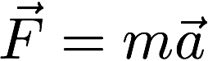
Newton’s 2nd Law
Newton’s 2nd law is a mathematical definition of force:
F is force
m is mass
a is acceleration
October 30, 08

Slide 22
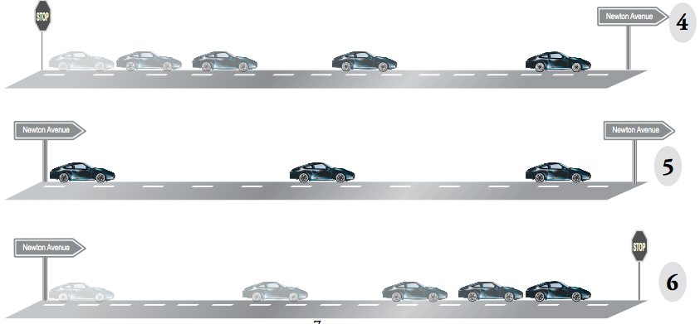
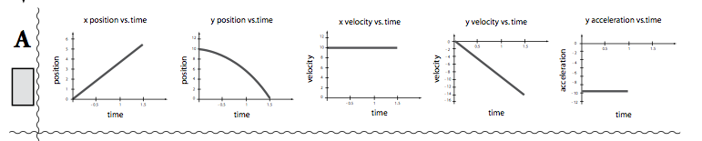
2nd Law Activities
Several activities involving matching graphical scenarios to plots of position, velocity or acceleration vs. time.
October 30, 08

Slide 23
Newton’s 3rd Law
Newton’s 3rd law states that for every action (force) there is an equal and opposite reaction (reactive force).
Note that this does not mean that you will necessary have an equal and opposite external force.
October 30, 08

Slide 24
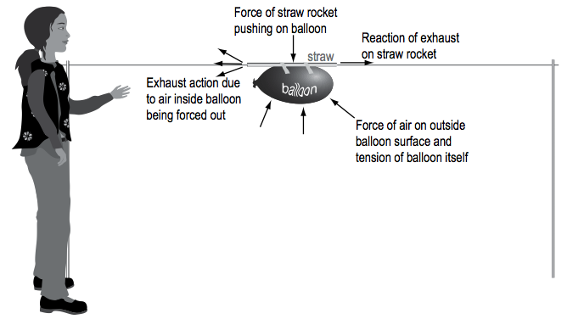
3rd Law Activities
Balloon races using a straw, string and tape
October 30, 08

Slide 25

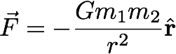
Newton’s Law of Gravitation
Newton’s Law of Gravitation states that the gravitational attraction between two objects is proportional to the product of their masses and inversely proportional to the square of their separation.
G = 6.67 x 10⁻¹¹ N m² kg⁻²
October 30, 08

Slide 26
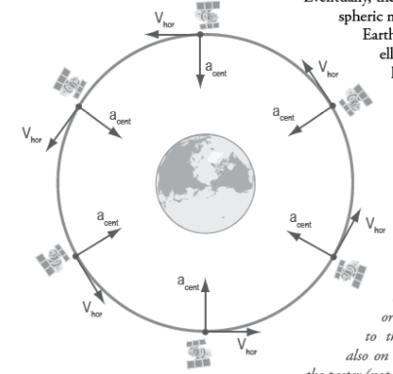
Gravitation Activities
Activity 1
Dropping objects of differing mass and size. Don’t tell students that all objects fall at the same rate. Rather, see if they can deduce it from their experiments.
Activity 2
This is a math activity where students fill out a table of surface gravities for the Sun and planets and then compare them.
October 30, 08

Slide 27
Ruler & Marbles
Place a plastic ruler on the table and bend one end up slightly to create a ramp. Place a glass marble into the slot in the center of the ruler. Put the marble on the flat part of the ruler. What will happen when you roll another glass marble into the stationary one? Try this with two marbles rolling down the groove and striking the stationary marble. Try it with a single marble sliding into two stationary ones. What will happen if you use marbles of obviously different masses (glass vs. steel, say)? Try rolling a glass marble into a steel marble, and vice versa. What will happen if you roll one marble from each side simultaneously into a stationary marble?
This is part of a suite of activities created by one of the SSU Education Ambassadors.
October 30, 08

Slide 28
Resources
Swift Education site:
http://swift.sonoma.edu
Swift Satellite:
http://swift.gsfc.nasa.gov
The Space Place:
http://spaceplace.nasa.gov
Space Science Education Resource Directory:
http://teachspacescience.org
NASA portal site for Swift:
http://www.nasa.gov/swift
October 30, 08

Slide 29
Please fill out your assessment forms now. Thank You!
October 30, 08

